Slide 1
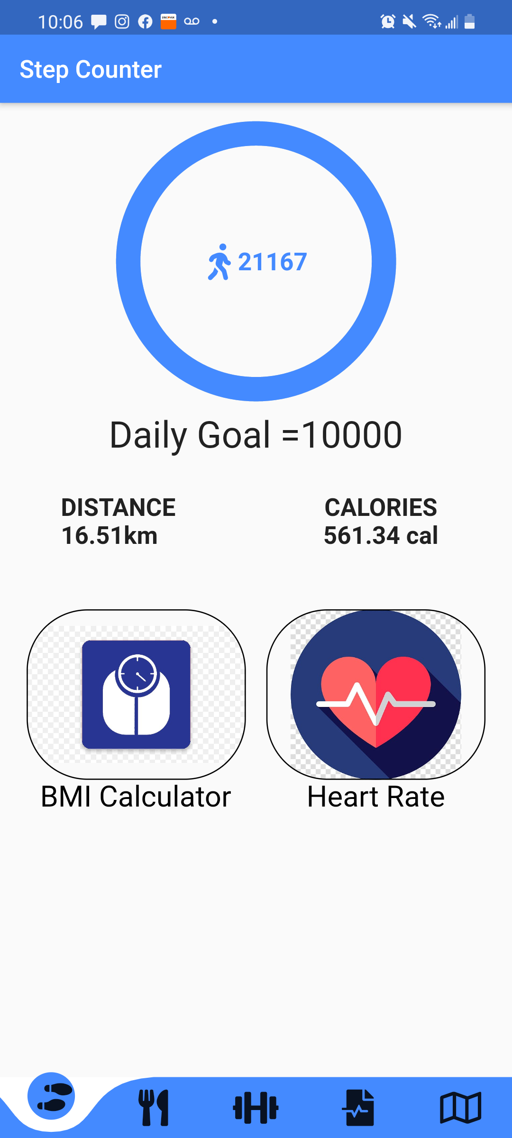
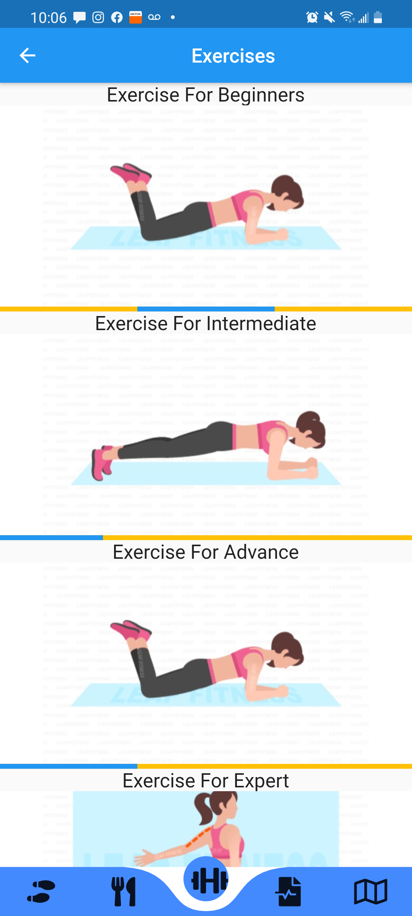


HEALTH COACH
Presented By: Roo-MATES
Dhairya Chandra
Tanvi jain
Ashish pant
Zeal patel

Slide 2
About health coach application
This app consists of all the features a person requires during this pandemic phase of "work from home". It focuses on physical as well as mental fitness through a perfect combination of features like daily steps, calorie and distance counter along with BMI calculator which helps you know about your body and set fitness goals based on that. And to cater this need, it contains various exercise routines easy to follow from home and also locates nearest gyms around your location. This app also offers amazing nutritious diet plans which will help you to eat healthy.
Mental health is as crucial as physical health in this era of isolation and this app takes care of that aspect as well. It has features like meditational/sleep/relaxing sounds to sooth your mind after a hectic day. The music therapy helps to reduce stress. And it offers motivational videos to keep you going through a tough day!
It has an exceptional chatbot through which you can send in your health symptoms and get a free suggestion and health advice.

Slide 3

FRAMEWORK USED

Slide 4


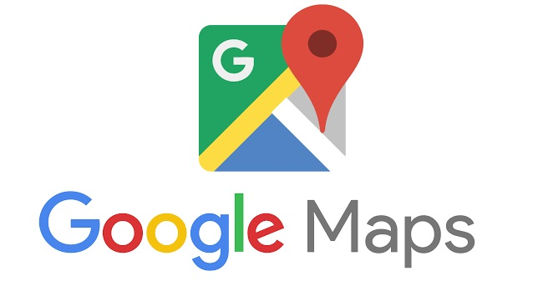

Integrations

Slide 5
FEATURES
SYMPTOMS CHECKER CHATBOT
(WITH COVID DETECTION)
FITNESS & WORKOUT
FOOD & NUTRITION
MENTAL FITNESS
Daily Steps Counter
Distance Calculator
Calories Counter
BMI Calculator
Different Exercise Modes
GYM Locator
7 Days Diet Plan
Weekly Diet
Weight Gain Diet
Weight Loss Diet
Other Diets
Sleep Sounds
Meditation Music
Motivational Videos
Reduce Stress
Music Therapy

Slide 6
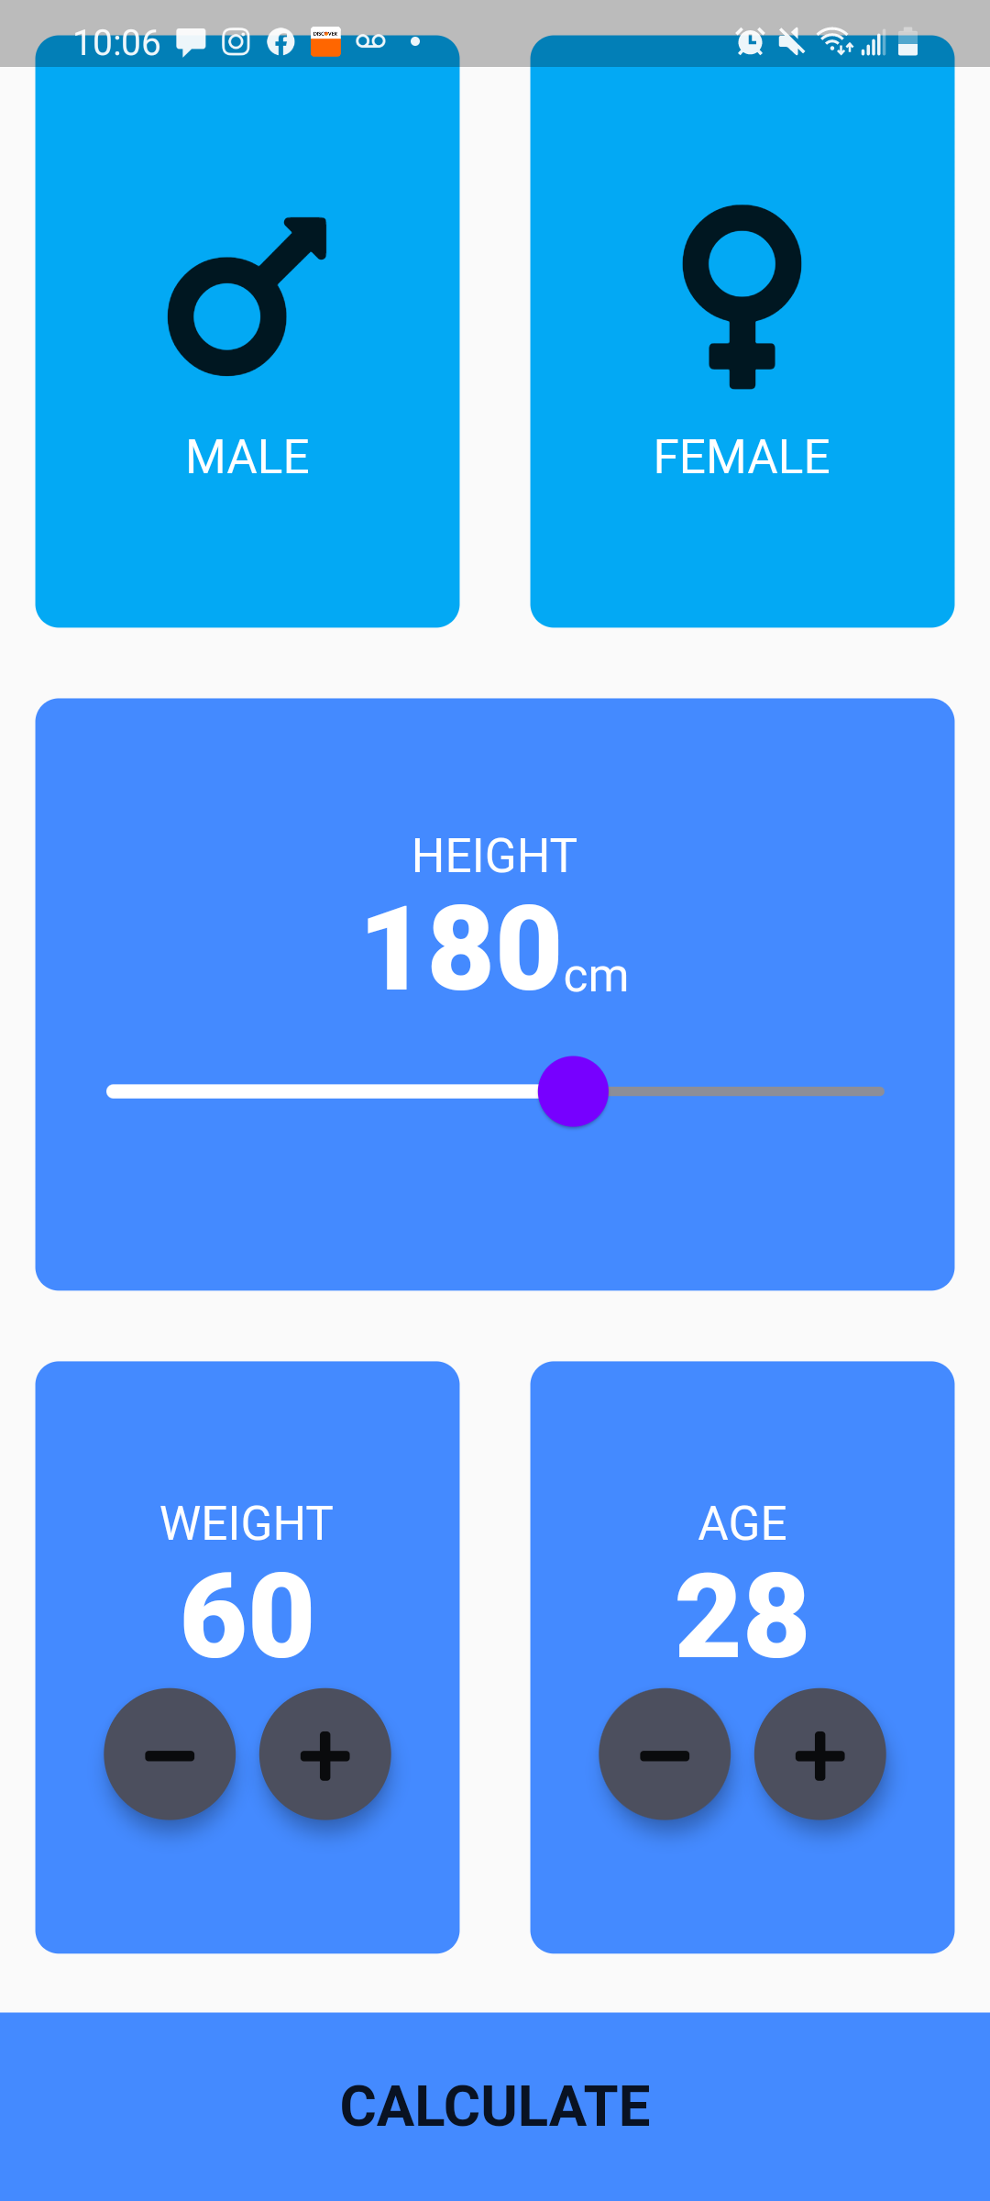
FITNESS & WORKOUT
Daily Steps Synced With Apple and Android Health Apps
Distance and Calories count based on steps
BMI Calculator
Gender
Height
Weight
Age
Heart Rate sensor

Slide 7
FITNESS & WORKOUT
Different Exercise Modes
Beginners
Intermediate
Advance
Expert

Slide 8
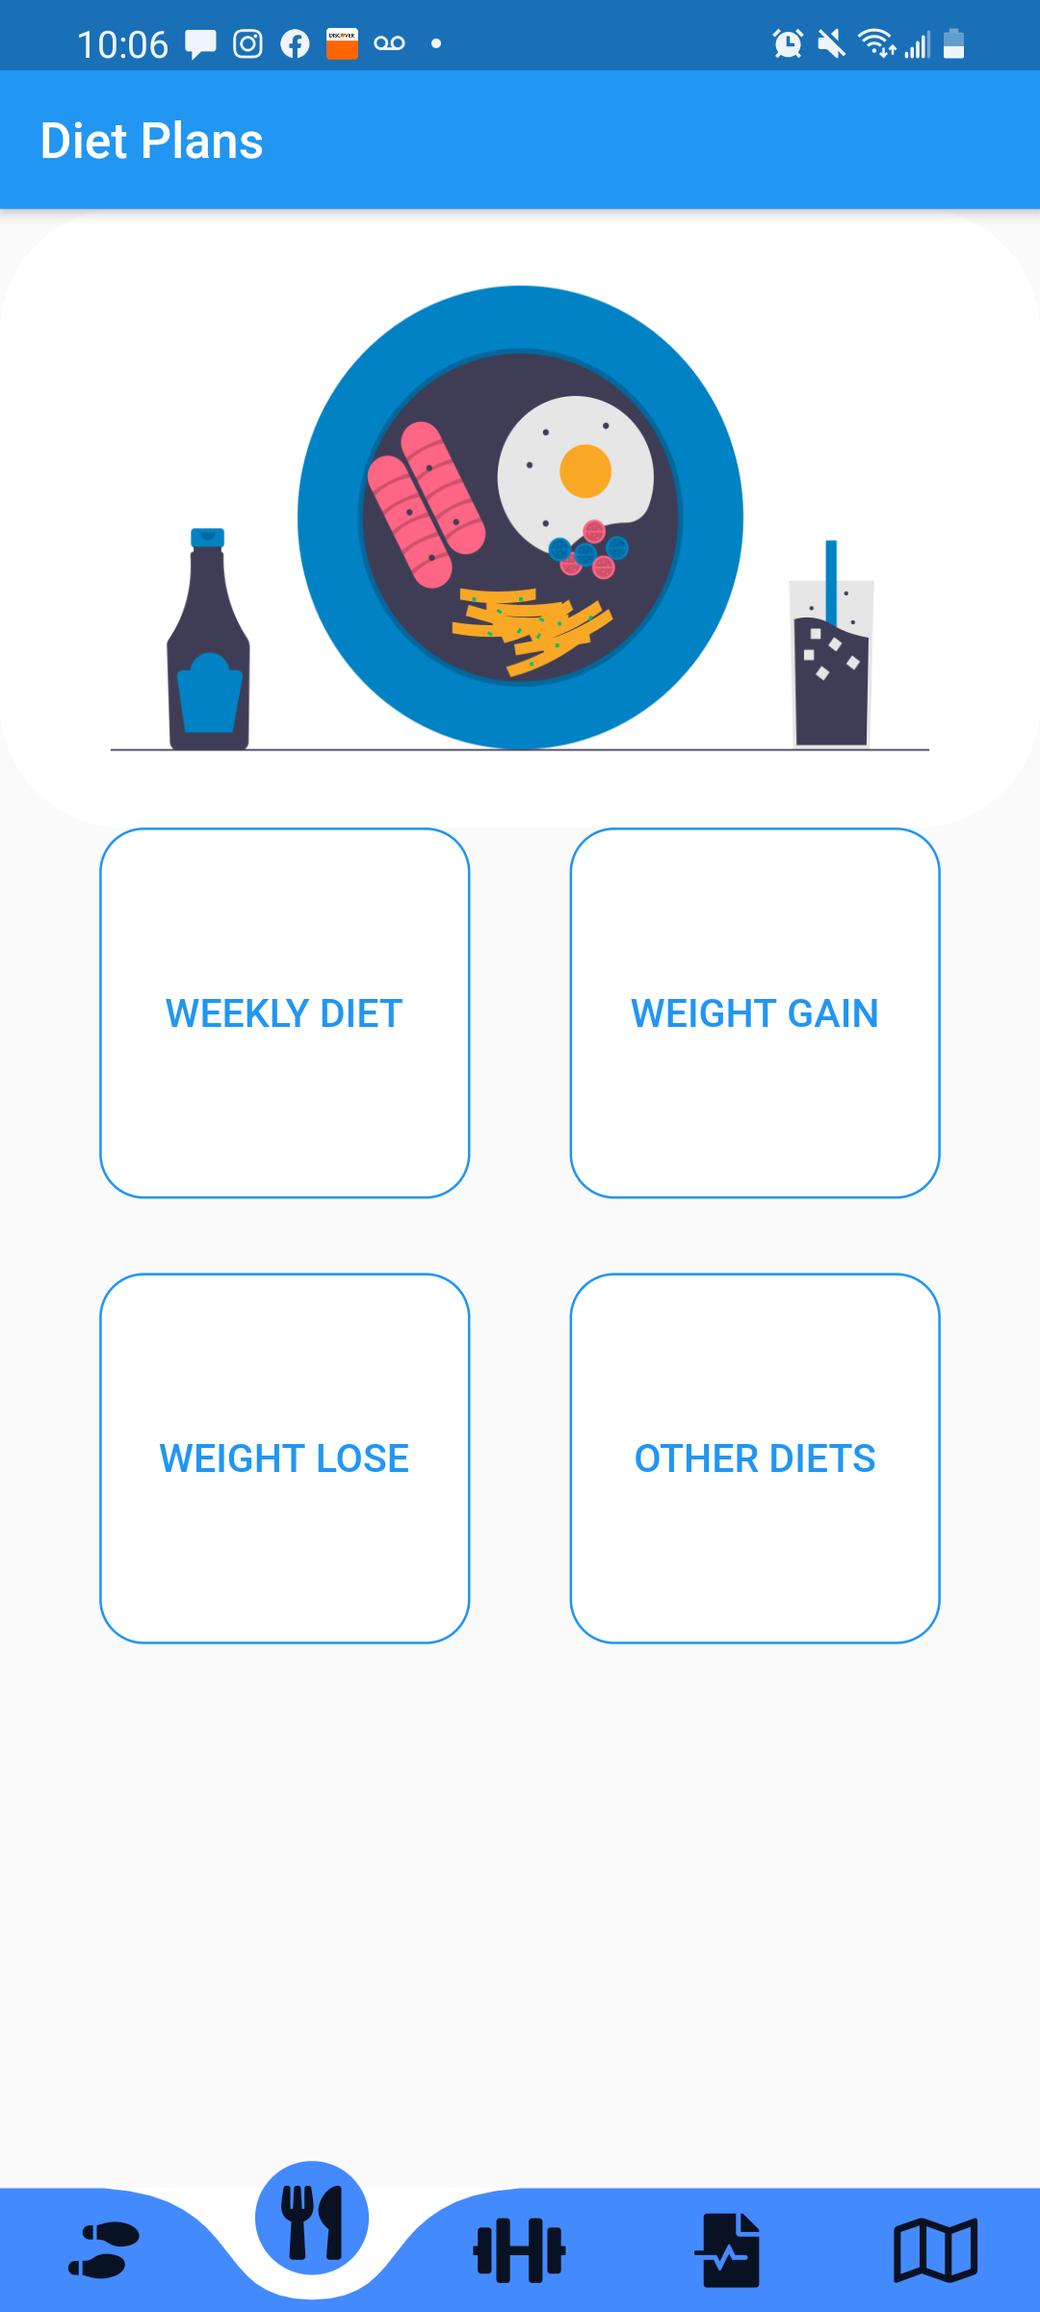
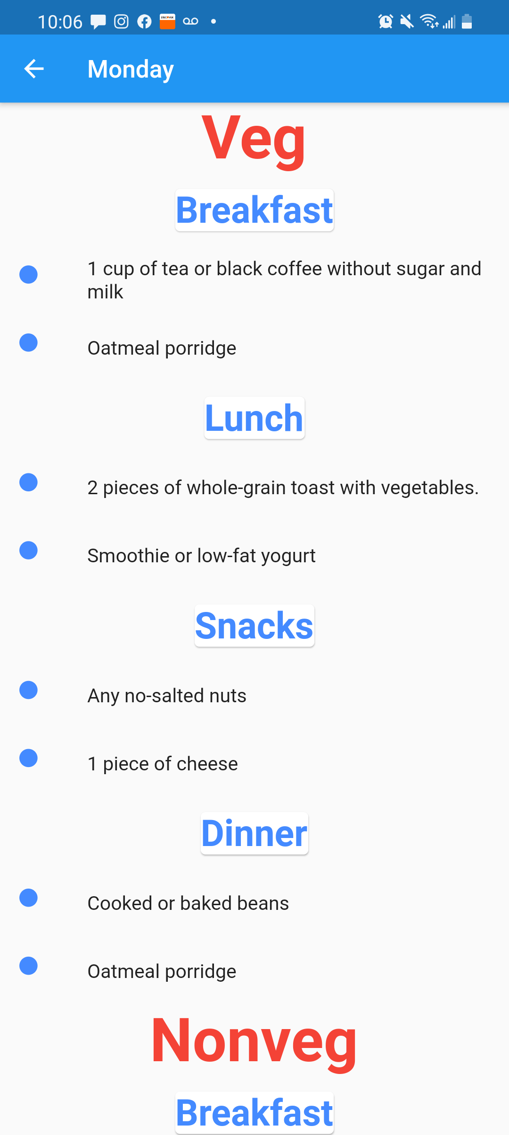
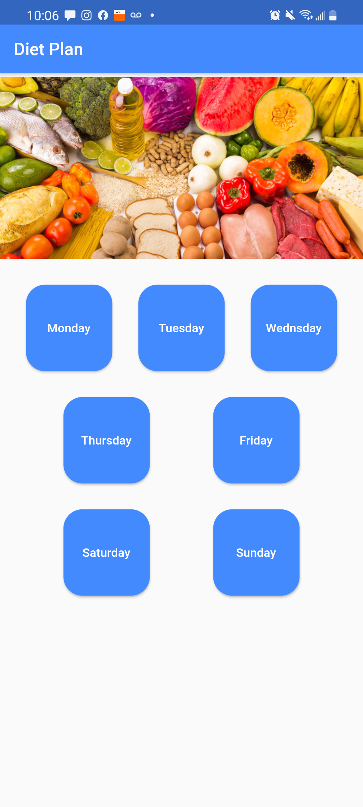
Food & Nutrition
Weekly Diet
7 Days plan (Veg/Non-Veg)
Breakfast, Lunch, Snacks, Dinner
Weight Gain Diet
Weight Loss Diet
Other Diets

Slide 9
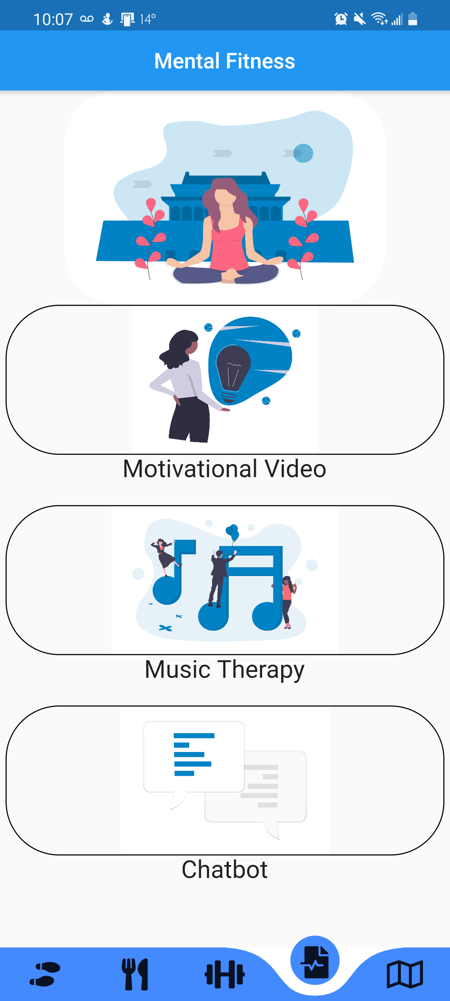
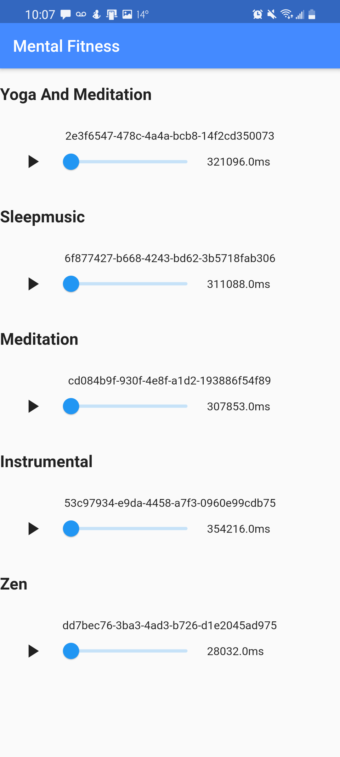
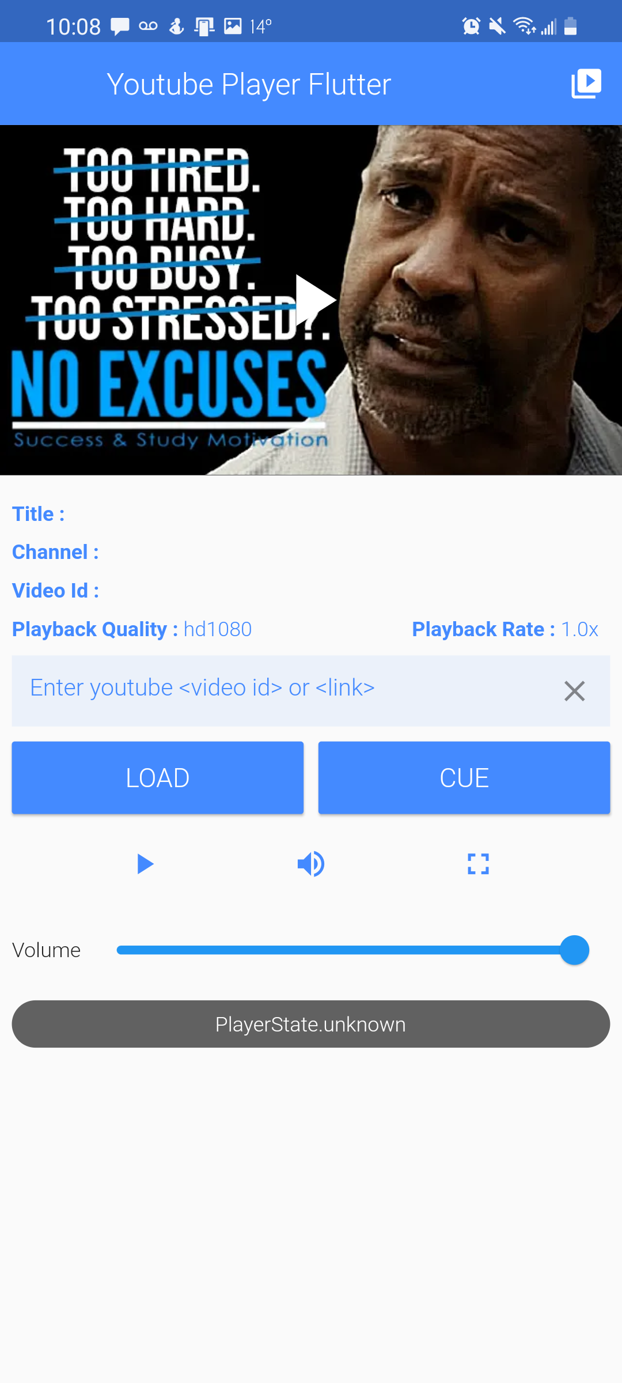
Mental fitness
Sleep Sounds
Meditation Music
Motivational Videos
Reduce Stress
Music Therapy

Slide 10
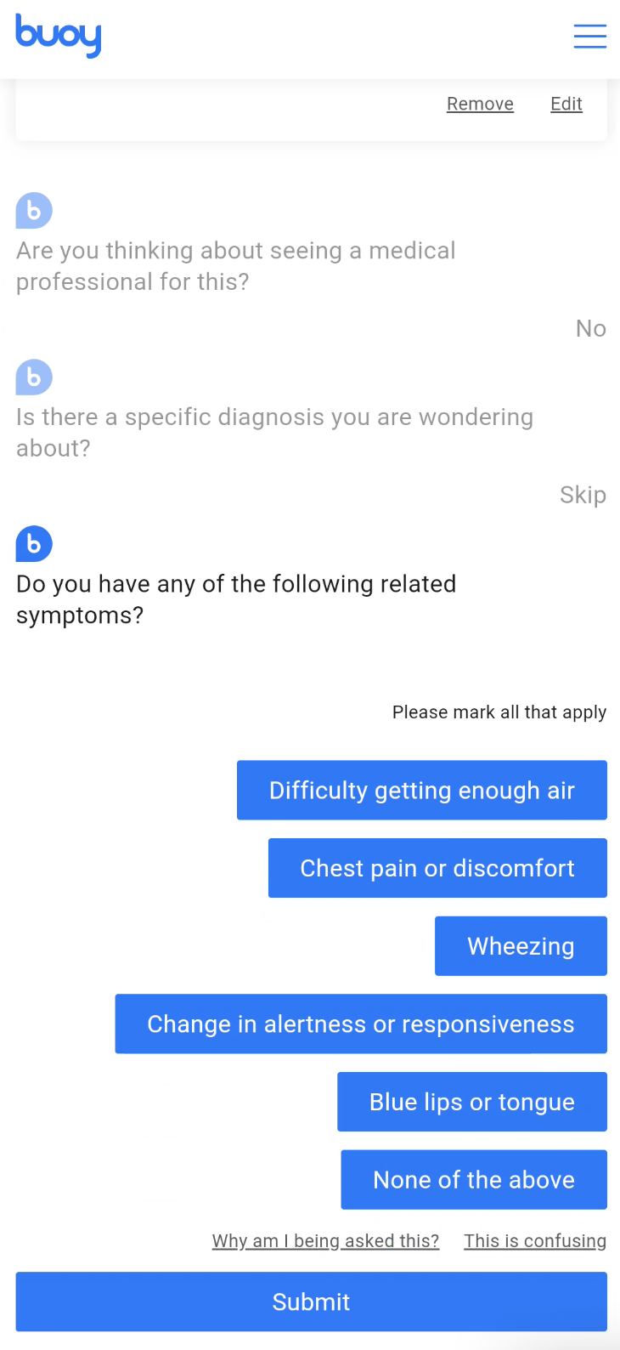
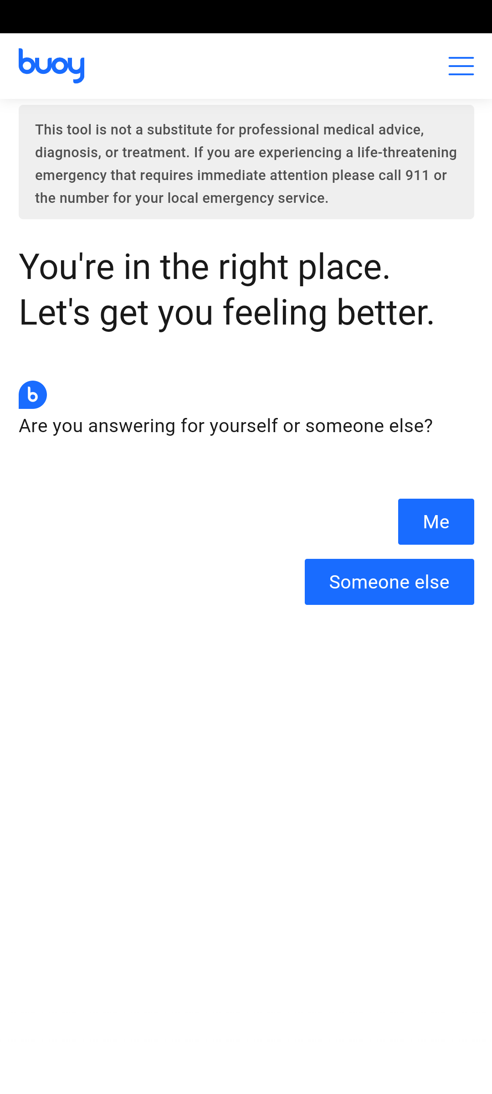
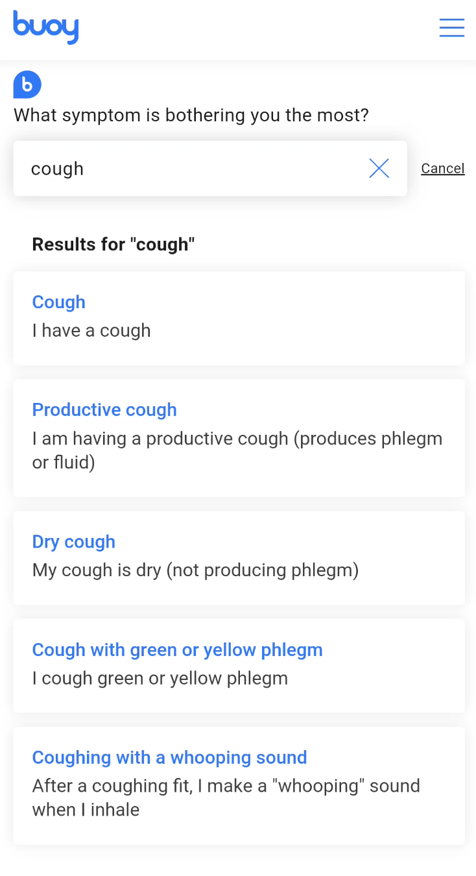
AI CHATBOT
Talks through your symptoms
Gives feedback on your symptoms
Guide you to the right service based on your condition

Slide 11
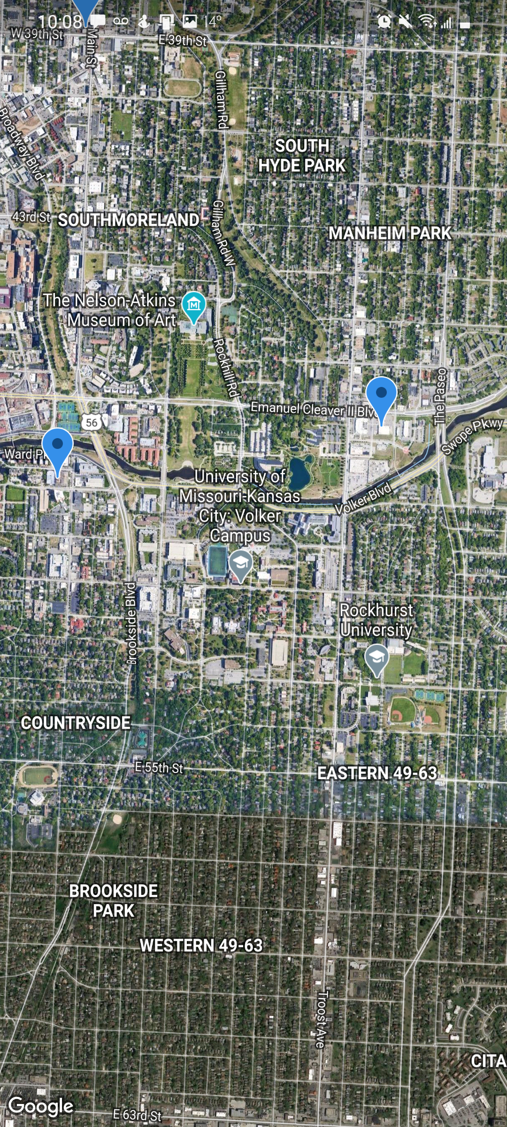
GYM LOCATOR
Near university of Missouri Kansas city
Data fetched using google maps

Slide 12
Important Links
APP WALKTHROUGH: https://youtu.be/_JYP4onzUYY
GITHUB: https://github.com/dhairyachandra/healthCoach_Hackaroo_2020

